Slide 1
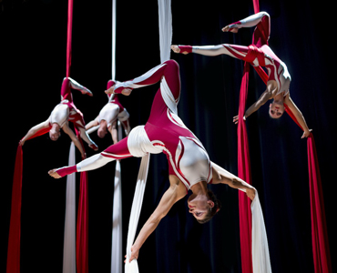
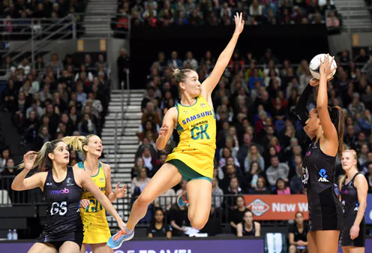
Post-Injury Recovery Comparisons: Aerial Circus Performers and Netball Players
Katy Coleman YEAR 2 BSc Psychology Student, Oxford Brookes University Circus Performer

Slide 2
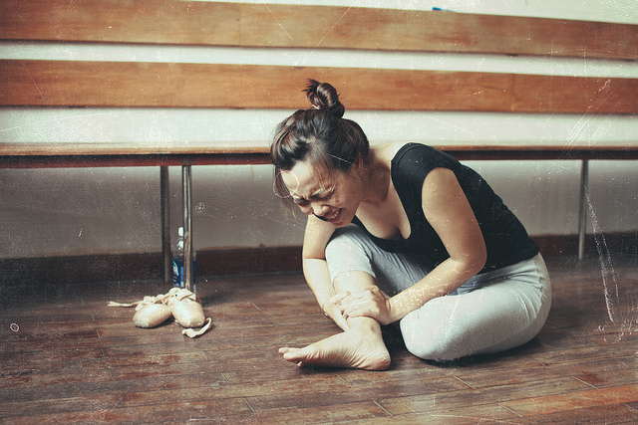
Introduction

Slide 3
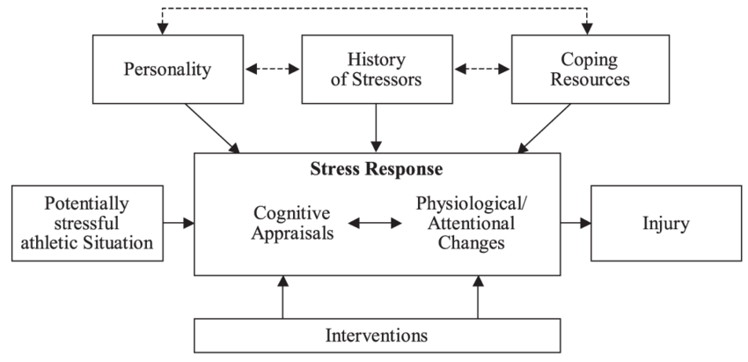
The Anderson and Williams (1988) Pre-injury Model

Slide 4
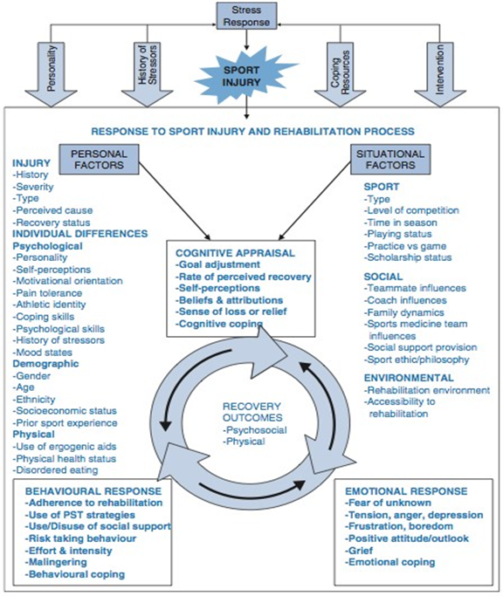
An Integrated Model of Response to Sport Injury: Psychological and Sociological Dynamics
Wiese-Bjornstal et al, 1998

Slide 5
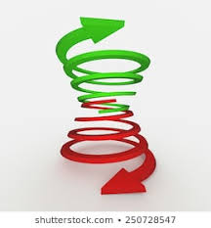
Recovery Outcome
Positive Outcome:
SPIRAL UPWARDS
COGNITIVE
EMOTIONAL
BEHAVIOURAL
BEHAVIOURAL
EMOTIONAL
COGNITIVE
Negative Outcome:
SPIRAL DOWNWARDS

Slide 6
Research Question Is the integrated model an effective tool in understanding the factors that affect sport-injury recovery across diverse sport types?
Elite Aerial Circus Performance
Collegiate Level netball

Slide 7
Questionnaire Design
PERSONAL FACTORS
SITUATIONAL FACTORS
COGNITIVE APPRAISAL EMOTIONAL RESPONSE BEHAVIOURAL RESPONSE

Slide 8
Participant Results
Participant | N1 | N2 | A1 | A2
Sport | Netball | Netball | Aerial Circus | Aerial Circus
Sport Level | Collegiate | Collegiate | Professional | Professional
Age | 20 | 21 | 41 | 40
Injury | Ruptured ACL in right knee. | Full ACL tear. | Right Shoulder Tears. | Smashed right and left heel bone.
Perceived Cause | Bad landing/ previous knee/ankle injuries. | Poor hamstring to quadricep strength ratio. | Overuse | Being complacent
Date of injury | March 2017 | March 2017 | August 2015 | November 2017
Return date | January 2018 | September 2018 | September 2016 | March 2018
Operation date | N/A (offered but declined) Diagnosed after 1 month | August 2017 (5 month wait) | April 2016 (8 month wait) | December 2017 (3 week wait)
Predicted recovery | 3-4 months post diagnosis | 6-9 months post-op | 4-6 months post-op | 1 year post-op
Actual recovery | 9 months | 13 months | 4 months | 3 months
Physical Injury status now | Normal function | Fully recovered | Not great even 3 years later | Fully recovered with some loss of flexibility

Slide 9
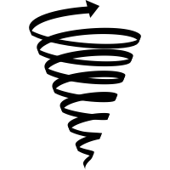
ACCEPTED INJURY QUICKLY
FRUSTRATED
EMOTIONAL RESPONSE
COGNITIVE APPRAISAL
GOOD EXPERIENCE BEING IN A WHEELCHAIR
CONCENTRATED ON GETTING BETTER
LEARNT A LOT ABOUT MYSELF
ALWAYS RECOVERED FROM PREVIOUS INJURIES FASTER THAN PREDICTED
REFUSED TO ACCEPT A NEGATIVE OUTCOME
MADE ME A STRONGER PERSON
SET GOALS FOR WALKING, TRAINING, PERFORMING
A2
DID 3-4 TIMES OVER PRESCRIBED PHYSIO
LOW LIFE STRESS PRE AND POST INJURY
WALKED BEFORE TOLD – KNEW WHAT I WAS CAPABLE OF
PERSONALITY:
DETERMINED, STUBBORN, EASY GOING
PERSONAL FACTORS
ACCEPTED INVALUABLE SUPPORT FROM BOYFRIEND
BEHAVIOURAL RESPONSE

Slide 10
HATED WATCHING OTHERS PERFORM – FOCUSED ON OTHER THINGS
FOCUSED ON PHYSIO
EMOTIONAL RESPONSE
COGNITIVE APPRAISAL
BEEN HERE MANY TIMES BEFORE – STILL A STRUGGLE
AFTER SURGERY DID NOT THINK ARM WOULD LIFT AGAIN
THOUGHT IT WOULD TAKE AT LEAST 2 YEARS TO HEAL – IF EVER
I KNEW THE RECOVERY PROCESS WOULD BE AWFUL
I’M GOING TO BE OUT OF ACTION FOR 6 MONTHS
ANGRY, DEPRESSED, FRUSTRATED
A1
STUCK TO PHYSIO, CHIROPRACTOR, MASSAGE 100%
HIGH LIFE STRESS PRE AND POST INJURY
ACCEPTED SUPPORT FROM FAMILY AND FRIENDS
ADRENALIN JUNKIE
STRESSFUL FAMILY
PROBABLY TRAINED TOO EARLY
BEHAVIOURAL RESPONSE
PERSONAL / SITUATIONAL FACTORS

Slide 11
Comparison – Recovery Outcome
 | N1 | N2 | A1 | A2
Recovery | Good but lengthy | Good but lengthy | Poor but on time | Good and quick
Life Stress pre-injury | Medium | Medium | High | Low
Life Stress post-injury | High | High | High | Low
Personality | Extrovert | Extrovert | Adrenalin junkie | Easy-going

Slide 12
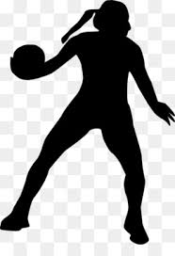
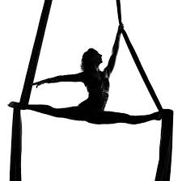
Comparison – Sport Type
 | N1 | N2 | A1 | A2
Perceived Cause | External | External | Internal | Internal
Coach | Yes | Yes | No | No
Return to Training Early | No | No | Yes | Yes
Fear of Unknown | Yes | Yes | No | No
Sporting Environment Access to Physio | Too expensive | Poor Quality | No | No
Adherence to Physio | 90% | 100% | 100% | 200%

Slide 13
Effective Model?
Valid questions
Useful responses
Became familiar with individual participants
Interesting parallels and differences
Limitations with questionnaire

Slide 14
Conclusion and Future Directions
Life Stress
Extrovert
Sport-Type
Perception of Injury Cause
Integrated Model

Slide 15
Acknowledgments
Oxford Brookes Sport and Exercise Module Leader Dr Adam Bibbey Thanks for inspiring this study and expecting the best from your students Oxford Brookes Senior Psychology Demonstrator Mr Wakefield Morys-Carter Thanks for helping with submission of this study to the BPS Conference and for your endless support on the degree
Group Members: George Crofts, Erin McGready, Ella McMurray, Rebecca Palmer Thanks for the initial inspiration and data collection of this study, and for being great company on the module

Slide 16
References
Andersen, M.B. and Williams, J.M., (1988). ‘A model of stress and athletic injury: Prediction and prevention’. Journal of sport and exercise psychology, 10(3), pp.294-306.
Clement, D., Arvinen-Barrow, M., & Fetty, T. (2015). ‘Psychosocial Responses During Different Phases of Sport-Injury Rehabilitation: A Qualitative Study’. Journal of Athletic Training, 50(1), 95–104. doi:10.4085/1062-6050-49.3.52
Dick, R., Berning, J., Dawson, W., Ginsburg, R., Miller, C. & Shybut, G. (2013) 'Athletes and the Arts — The Role of Sports Medicine in the Performing Arts.' Current Sports Medicine Reports, 12(6), pp.397-403
Ford, I. W., Eklund, R. C., & Gordon, S. (2000). ‘An examination of psychosocial variables moderating the relationship between life stress and injury time-loss among athletes of a high standard’. Journal of Sports Sciences, 18(5), 301–312.doi:10.1080/026404100402368
Galambos, S. A., Terry, P. C. & Moyle, G. M. (2005) ‘Psychological predictors of injury among elite athletes.’ British Journal of Sports Medicine; 39:351-354.
Heil, J (1993). ‘Psychology of sport injury.’ USA: Human Kinetics. Pp.33-47.
Johnston, L. H., & Carroll, D. (1998). ‘The Context of Emotional Responses to Athletic Injury: A Qualitative Analysis’. Journal of Sport Rehabilitation, 7(3), 206–220. doi:10.1123/jsr.7.3.206
Kerr, G., & Minden, H. (1988). ‘Psychological Factors Related to the Occurrence of Athletic injuries’. Journal of Sport and Exercise Psychology, 10(2), 167–173.doi:10.1123/jsep.10.2.167
Shrier, I. & Halle, M. (2010). 'Psychological Predictors of Injuries in Circus Artists: An Exploratory Study.' British Journal of Sports Medicine, 45(5), pp.433–436. doi:10.1136/bjsm.2009.067751
Smith, A. M., Stuart, M. J., Wiese-Bjornstal, D. M., & Gunnon, C. (1997). ‘Predictors of Injury in Ice Hockey Players: A Multivariate, Multidisciplinary Approach’. The American Journal of Sports Medicine, 25(4), 500–507. https://doi.org/10.1177/036354659702500413
Walker, N., Thatcher, J., & Lavallee, D. (2007). ‘Psychological responses to injury in competitive sport: a critical review.’ The Journal of the Royal Society for the Promotion of Health, 127(4), 174–180.doi:10.1177/1466424007079494
Wiese-Bjornstal, D. M., Smith, A. M. and LaMott. E. E. "A model of psychologic response to athletic injury and rehabilitation." Athletic training: sports health care perspectives 1.1 (1995): 17-30. Wiese-bjornstal, D. M., Smith, A. M., Shaffer, S. M. and Morrey, M. A. (1998). An integrated model of response to sport injury: Psychological and sociological dynamics. Journal of Applied Sport Psychology . 10 (1), pp.46-69.

Slide 17
APPENDIX I – Questionnaire: Personal + Situational Factors
INDIVIDUAL DIFFERENCES
Psychological
Personality Type (how would you describe your personality):
Life Stress pre-injury (were you suffering from life stresses pre-injury and if so were these Low / Medium / High? Please elaborate): Life Stress post-injury (were you suffering from life stresses post-injury and if so were these Low / Medium / High? please elaborate):
Demographic
Age:
Gender:
Ethnicity:
Physical
How would you describe your… Physical health status pre-injury: Physical health status post-injury:
Eating habits pre-injury: Eating habits post-injury:
SITUATIONAL FACTORS SPORT Type: Level: SOCIAL Team-mate Influence (do you train/compete/perform with a team?): What attitude is shared in your team in regards to injury? Coach influence (do you have a coach/trainer?): How do you perceive your coach / trainer’s attitude towards athletes / performers whom are injured? Family dynamic (is your family supportive and/or stressful?): ENVIRONMENTAL Rehabilitation environment (does your sporting environment support the idea of rehabilitation?) ELABORATE: Accessibility to rehabilitation (does your sporting environment offer access to rehabilitation?) ELABORATE:

Slide 18
APPENDIX II – Questionnaire: Dynamic Core
COGNITIVE APPRAISAL (Q1. – please elaborate)
What were your initial thoughts immediately after the injury took place?
a) What did you tell yourself in order to cope with your injury?
(Q2 – Q4)
Did you adjust your sporting goals post-injury?
Did you feel a sense of loss or were you relieved to have a break from training?
How long did you think it would take to heal?
EMOTIONAL RESPONSE (Q1. Please elaborate)
How did you feel…
Immediately after the injury? / Days after the injury? / Weeks after the injury?
(Q2 – Q6)
How did you emotionally cope with your injury?
Did you fear the unknown?
Did you feel angry, tense or depressed?
Did you feel frustrated and bored?
Did you feel a sense of grief?
BEHAVIOURAL RESPONSE (Q1. Please elaborate)
How did you rehabilitate from this injury? What actions did you take to recover?
(Q2 – Q6.)
Did you stick to your rehabilitation plan? Did you stay focussed on your rehab plan?
Did you use social support or did you disuse social support?
Did you engage in risk-taking behaviours? (e.g. training too early)
How much effort and intensity did you put into rehabilitation?
Did you pretend to be injured in order to escape responsibility at any point?

Slide 19
APPENDIX III – Example Analysis
COGNITIVE APPRAISAL
OVERARCHING
Initial thoughts after injury | Frustrated, embarrassed in front of large crowd. Disappointed after training so hard – previously excited about playing in varsity | Upset, angry | Fuck, I’ve just torn my shoulder! That’s going to need surgery and I’m going to be out of action for 6 months. Angry | I was sure that I would recover. Doctors in Ireland told me to cancel all my gigs for the year and that it would be a long time till I walked again, never mind train, but I didn’t accept that
What did you tell yourself in order to cope? | Wasn’t the end of the world, I could definitely come back from this. Hard work and determination were two key words I kept repeating to myself | That it will all be sorted out eventually and then I can play netball again if I do my physio | I had been there many times before but it was still a struggle. Focused on rehab and kept rest of body supple / conditioned | Tried to accept where I was at. Accepted everything happens for a reason. Concentrated on getting better. Set goals for walking, training and performing
PROMPTS
Adjust sporting goals post-injury? | Kept adjusting based on rehab progress. Aim: to play netball again small goals set to work toward this | No – kept goals the same for when I returned to netball | I have been adjusting goals since I broke my neck age 25, so just glad to be doing anything | Don’t think so - Set goals for walking, training and performing
Sense of loss or relief? | Quite lost, went to every training session, hard sitting on side-lines, overwhelming and frustrating not being able to even run | Huge sense of loss | Both. Generally an injury is from overdoing it so always a sense of relief to get a break. But sense of loss of the tricks you can no longer do | Missed training – focused on rehab
How long did you think it would take to heal? | Initially told it would take 3 – 4 months – believed this advice - but recovery was slower. Took one month to get diagnosis. | 12 months post-op | At least 2 years, if ever | Wasn’t sure, but had injuries before and always pushed through them quicker than doctors prediction. Set myself goal of March 2018 training after surgery

